Slide 1
Paper details
Author name: M. 15it217, Vikram, and P. Ananthanarayana.
Paper name: A YOLO Based Approach for Traffic
Sign Detection.
Paper Link: https://vikram-mm.github.io/yolo_report.pdf
Publisher name: 15IT217 M M Vikram.
Paper Architecture: Yolov8m

Slide 2
Dataset
Link: https://www.kaggle.com/datasets/valentynsichkar/traffic-signs-dataset-in-yolo-format
Number of samples:900
Number of training data: 630
Number of test data: 111
Classes number: 3
Classes labels: [“prohibitory” , ” danger” , “mandatory” , ” other”]
The dimension of images: 3 RGB

Slide 3
Results of training

Slide 4

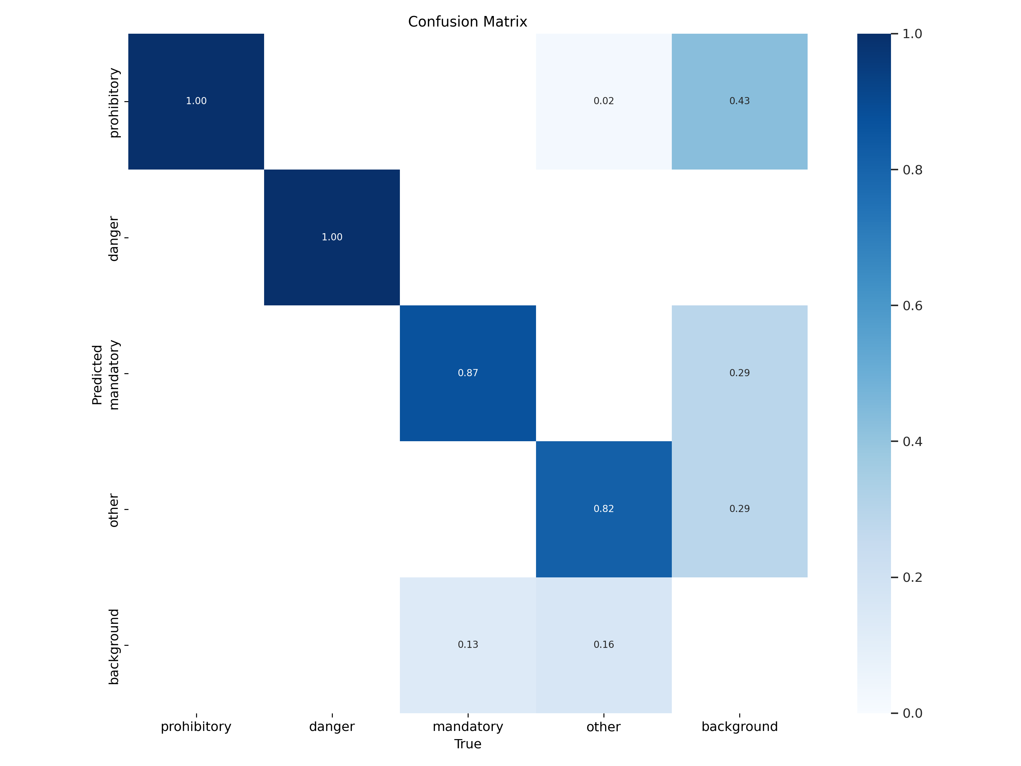
Confusion matrix

Slide 5
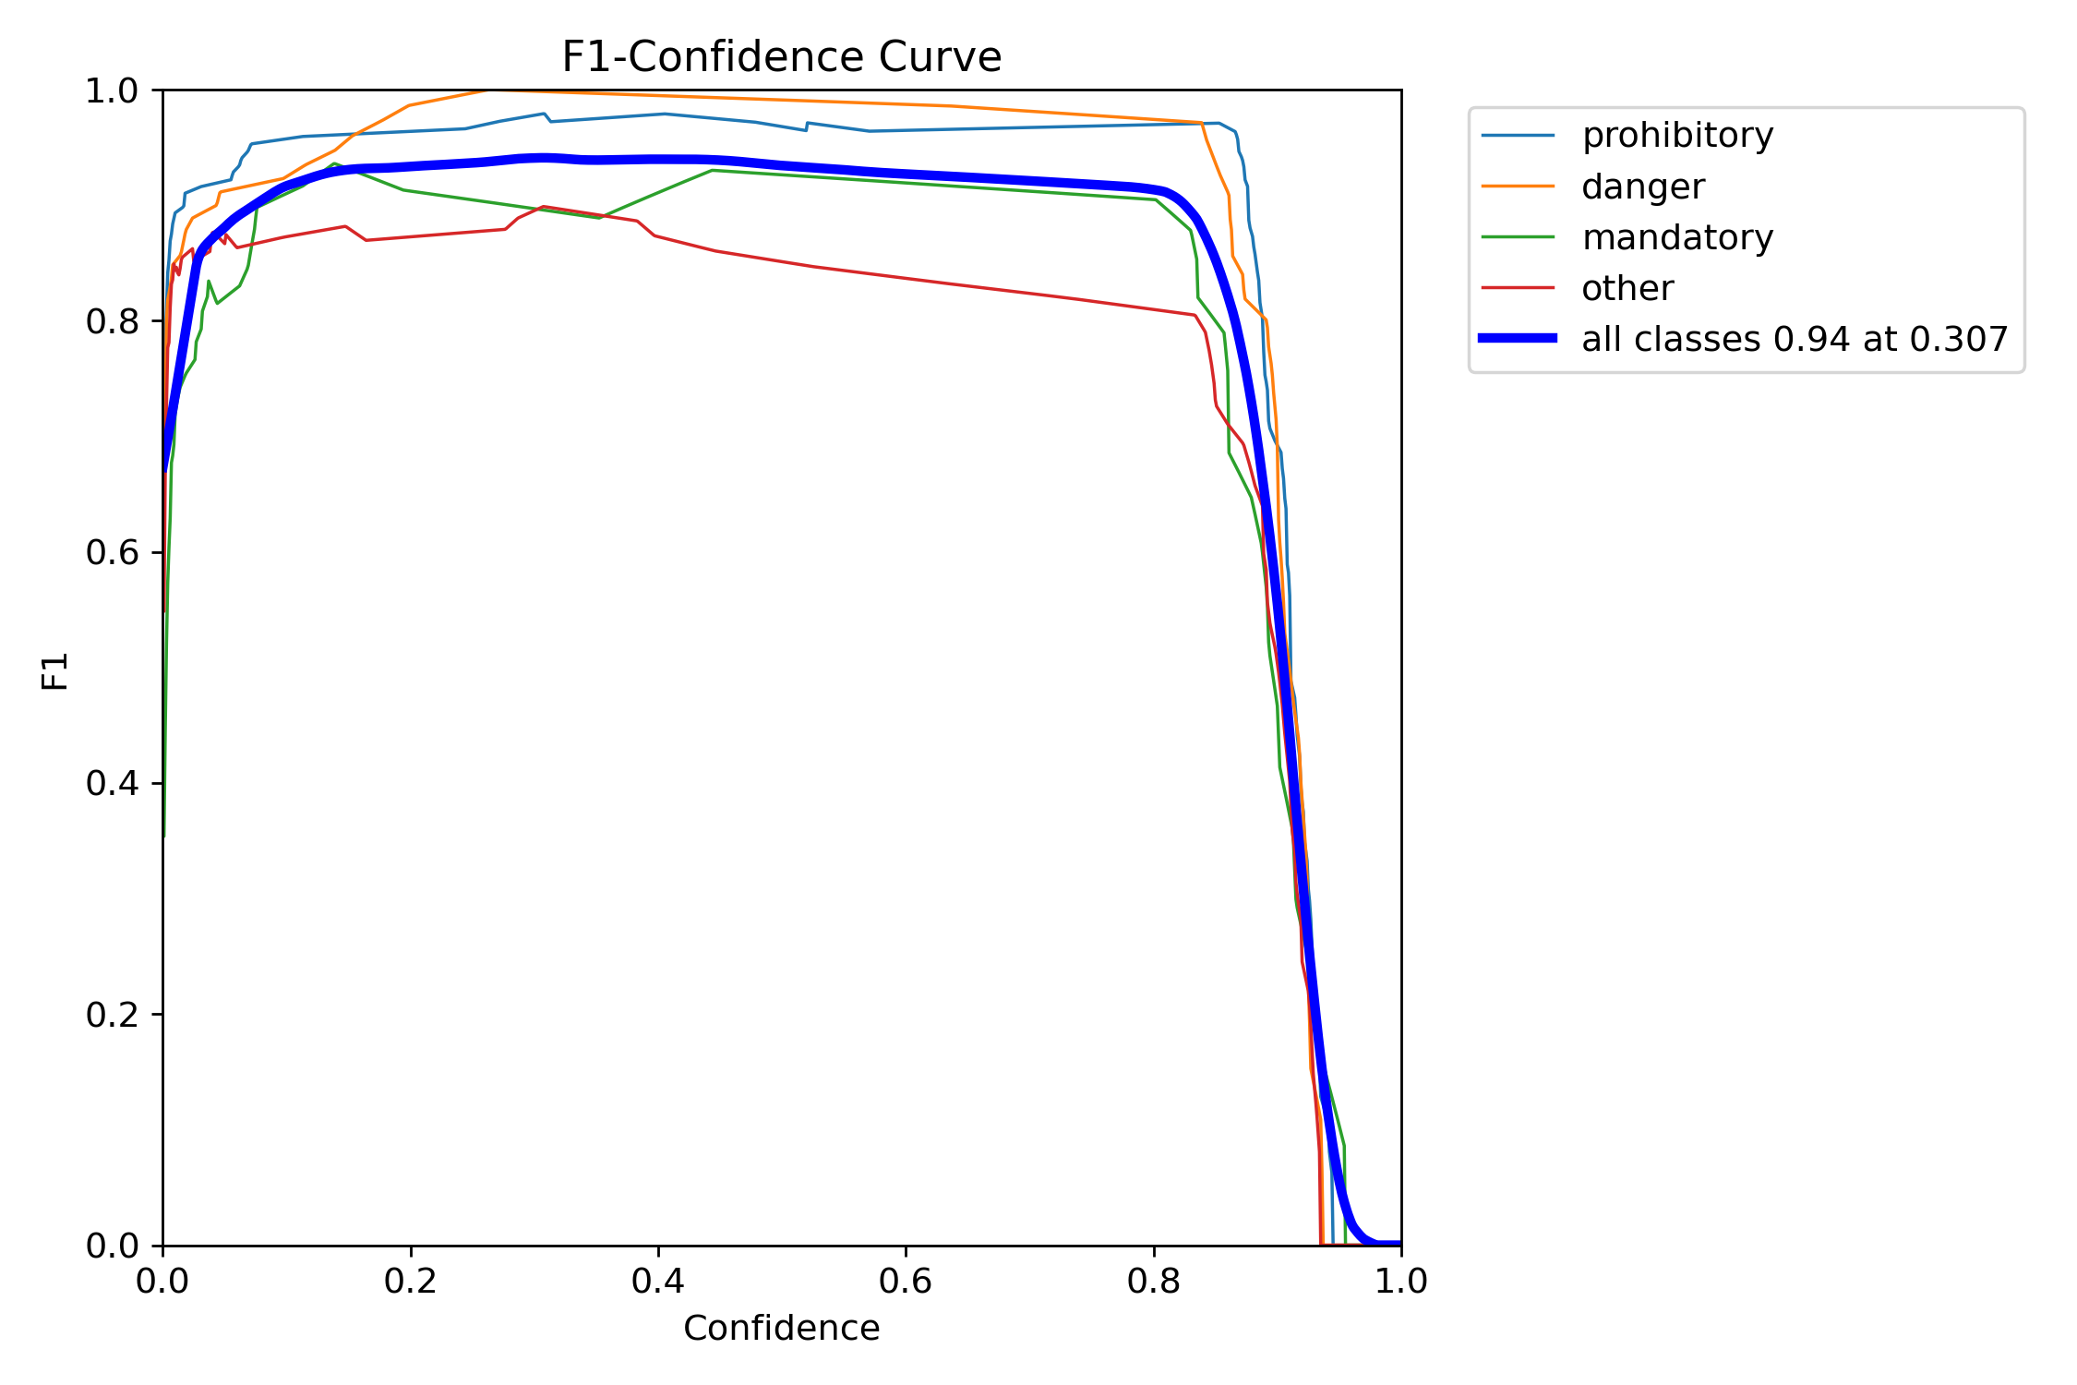
F1 SCORE

Slide 6
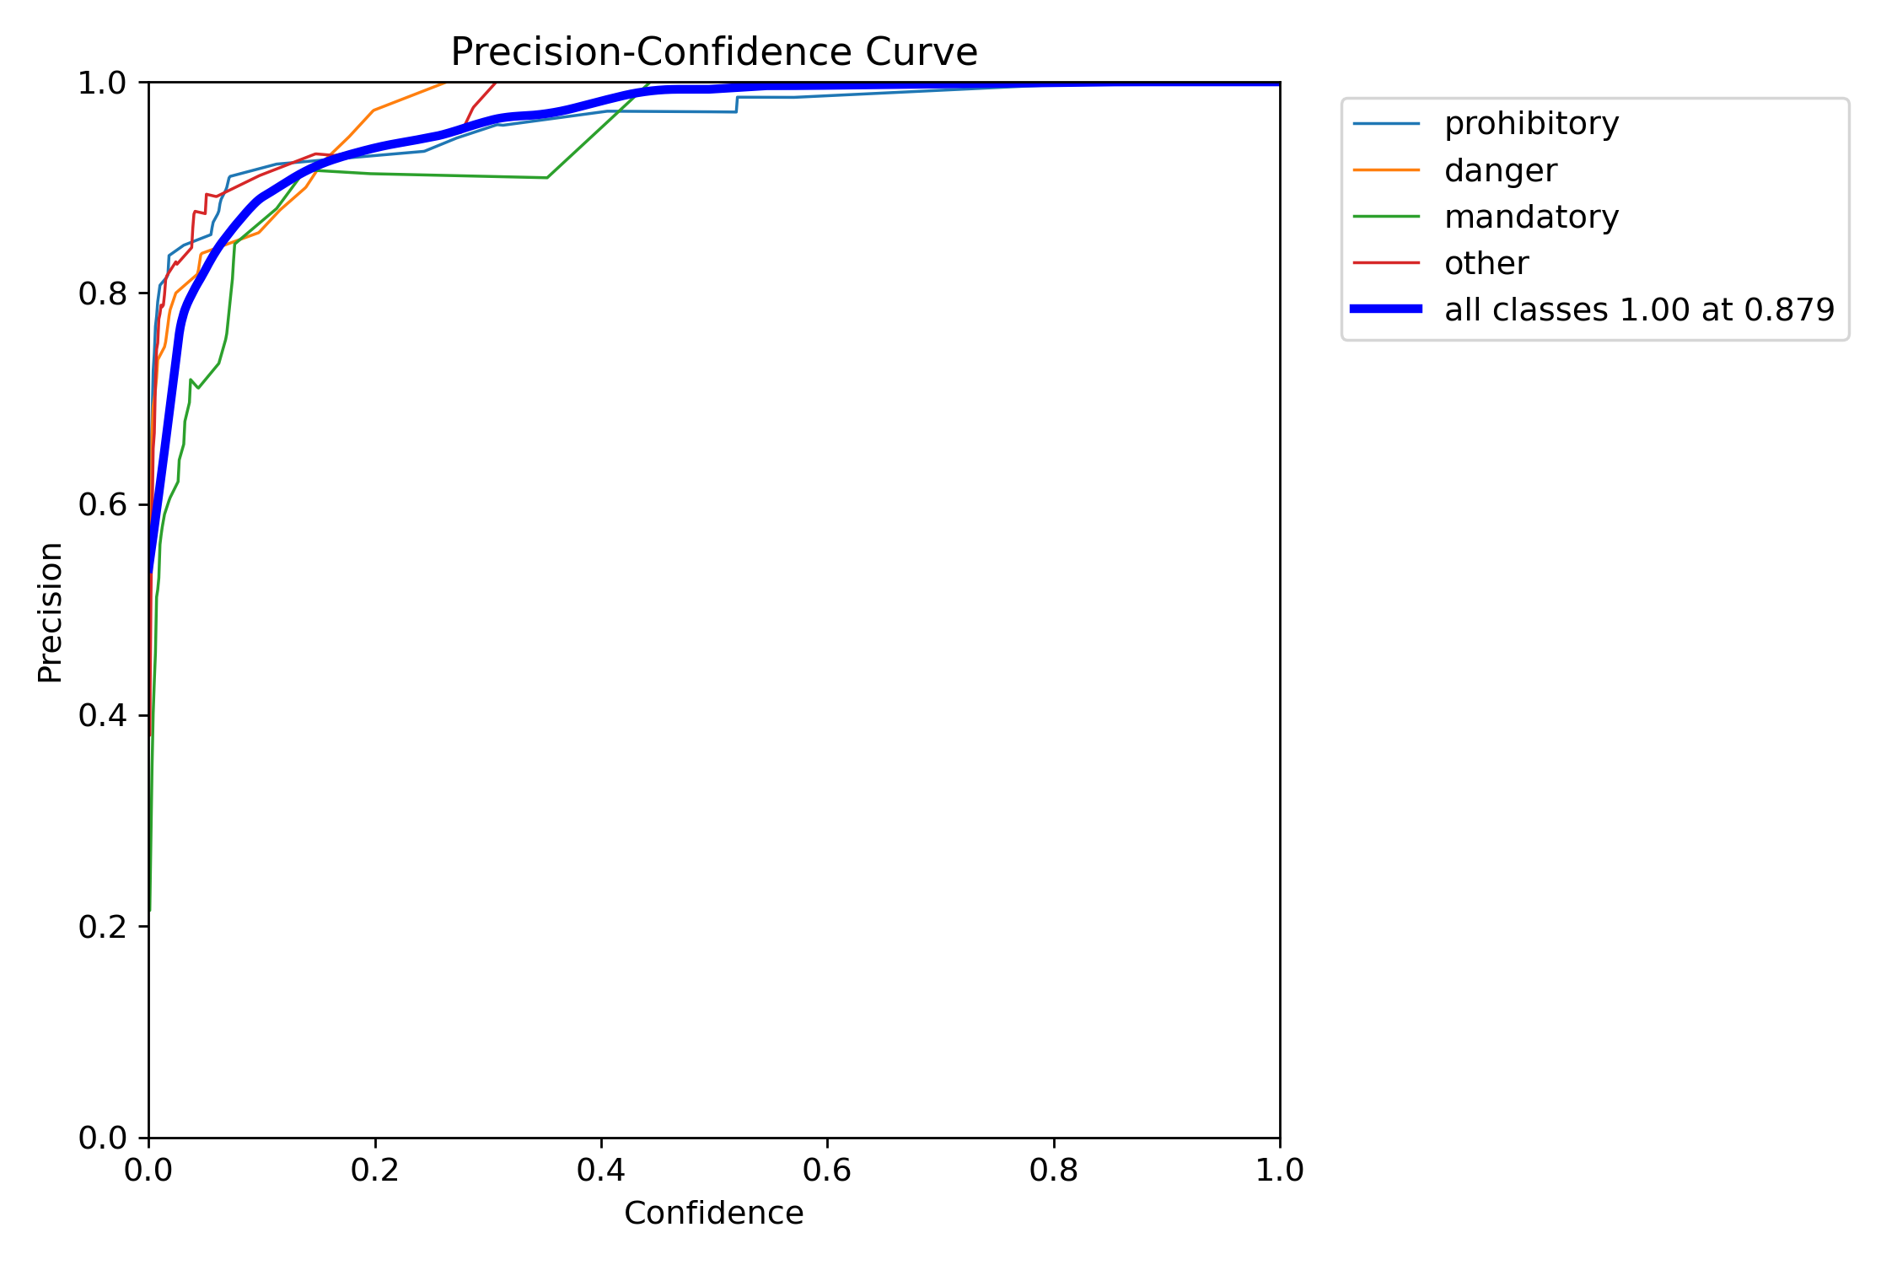
precision CURVE

Slide 7
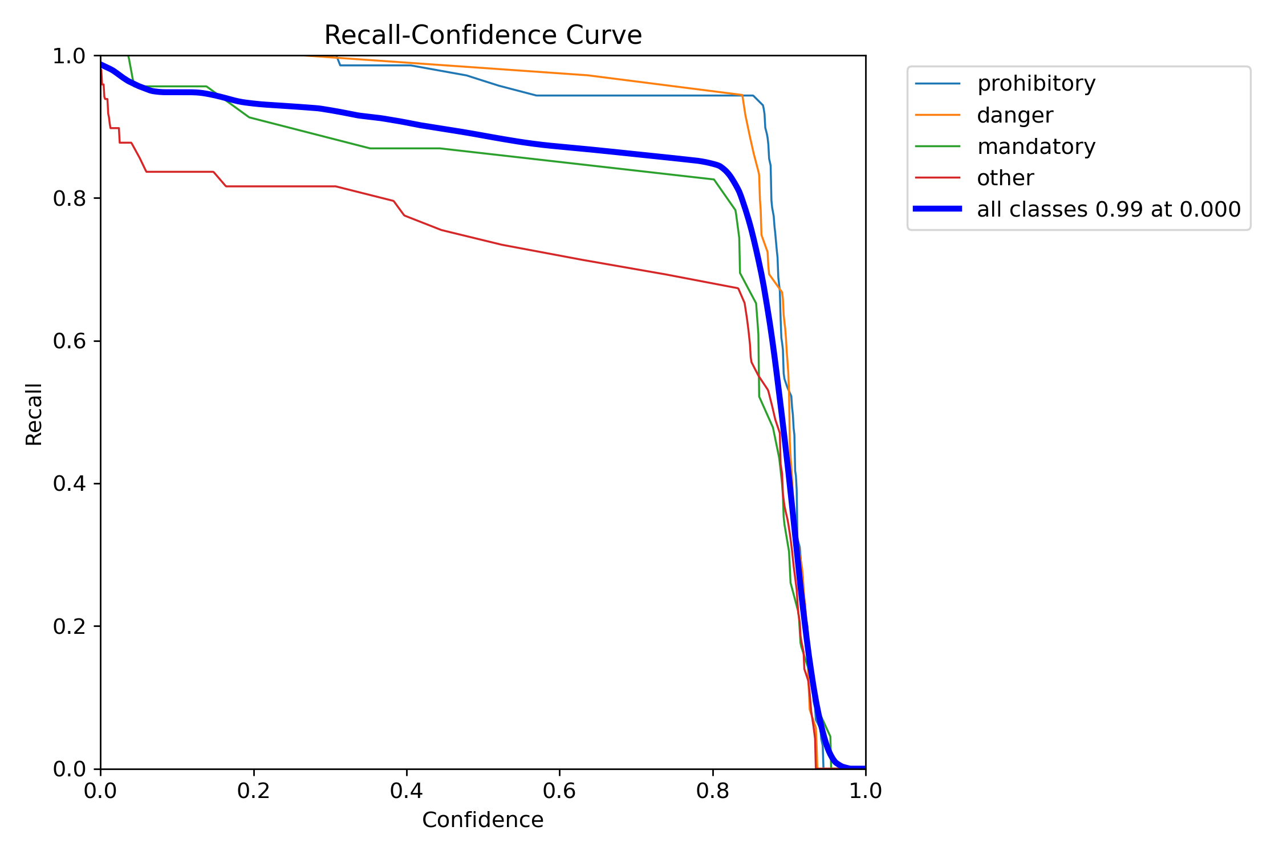
Recall CURVE

Slide 8
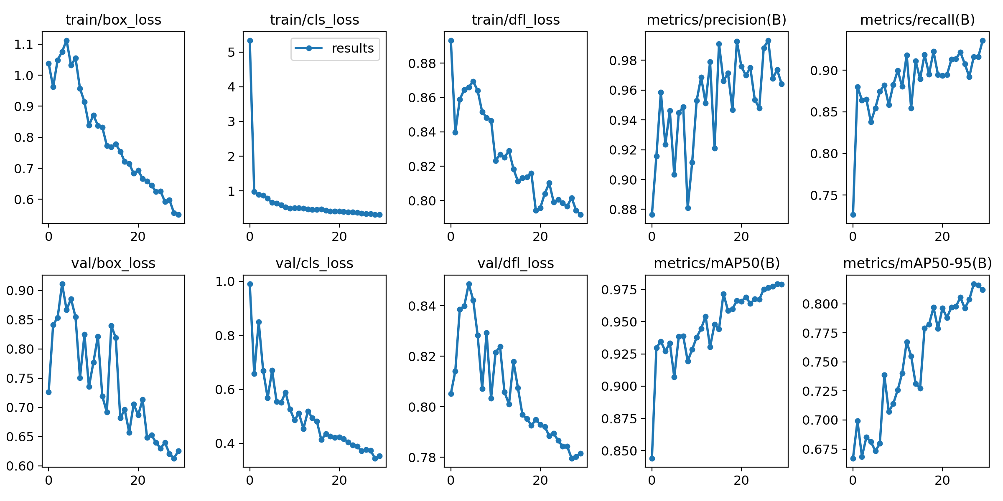
Results CURVE

Slide 9
Results of validation

Slide 10
Confusion
matrix

Slide 11


F1 SCORE

Slide 12

precision CURVE

Slide 13
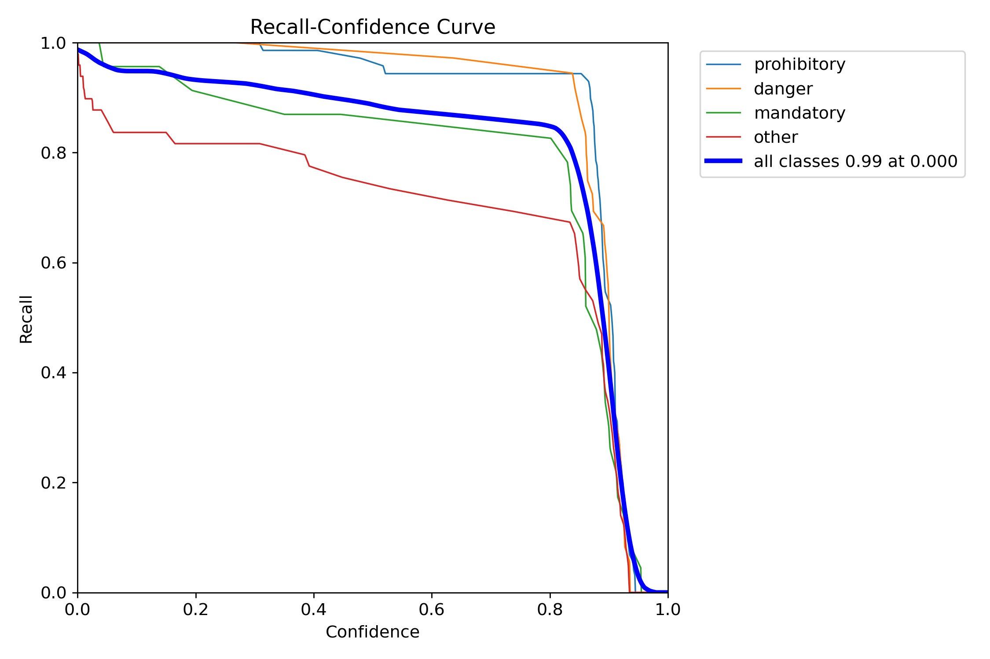
Recall CURVE

Slide 14
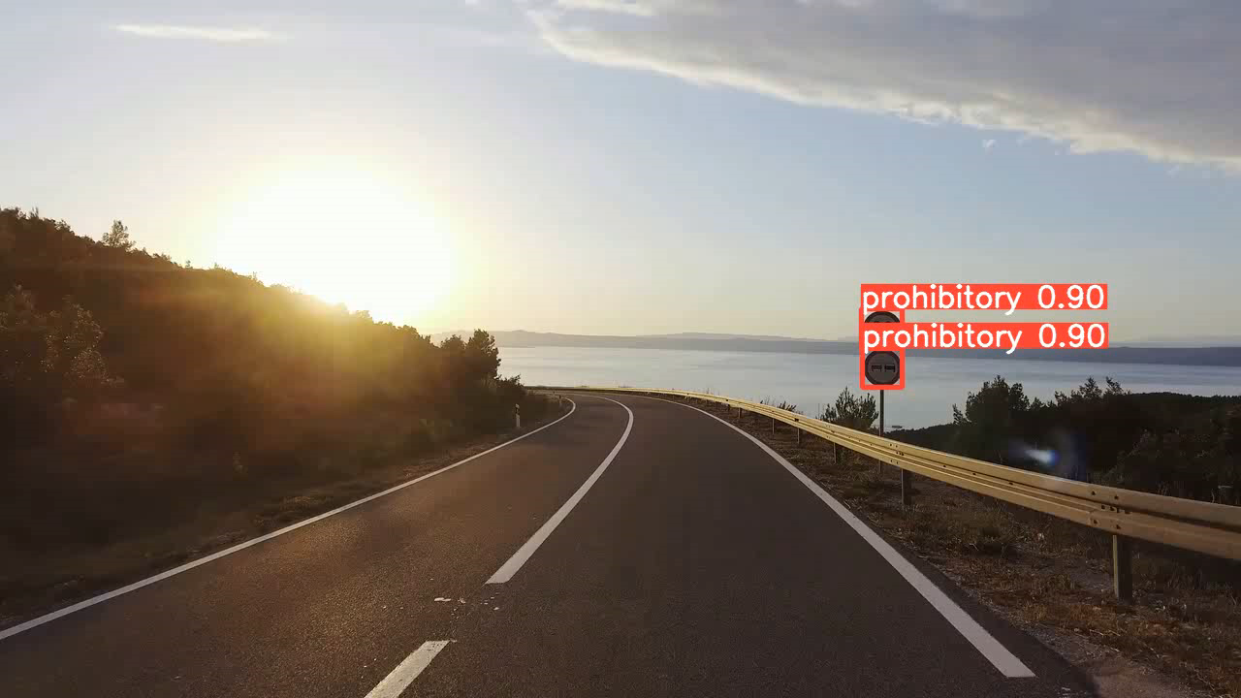
Result of test

